Slide 1
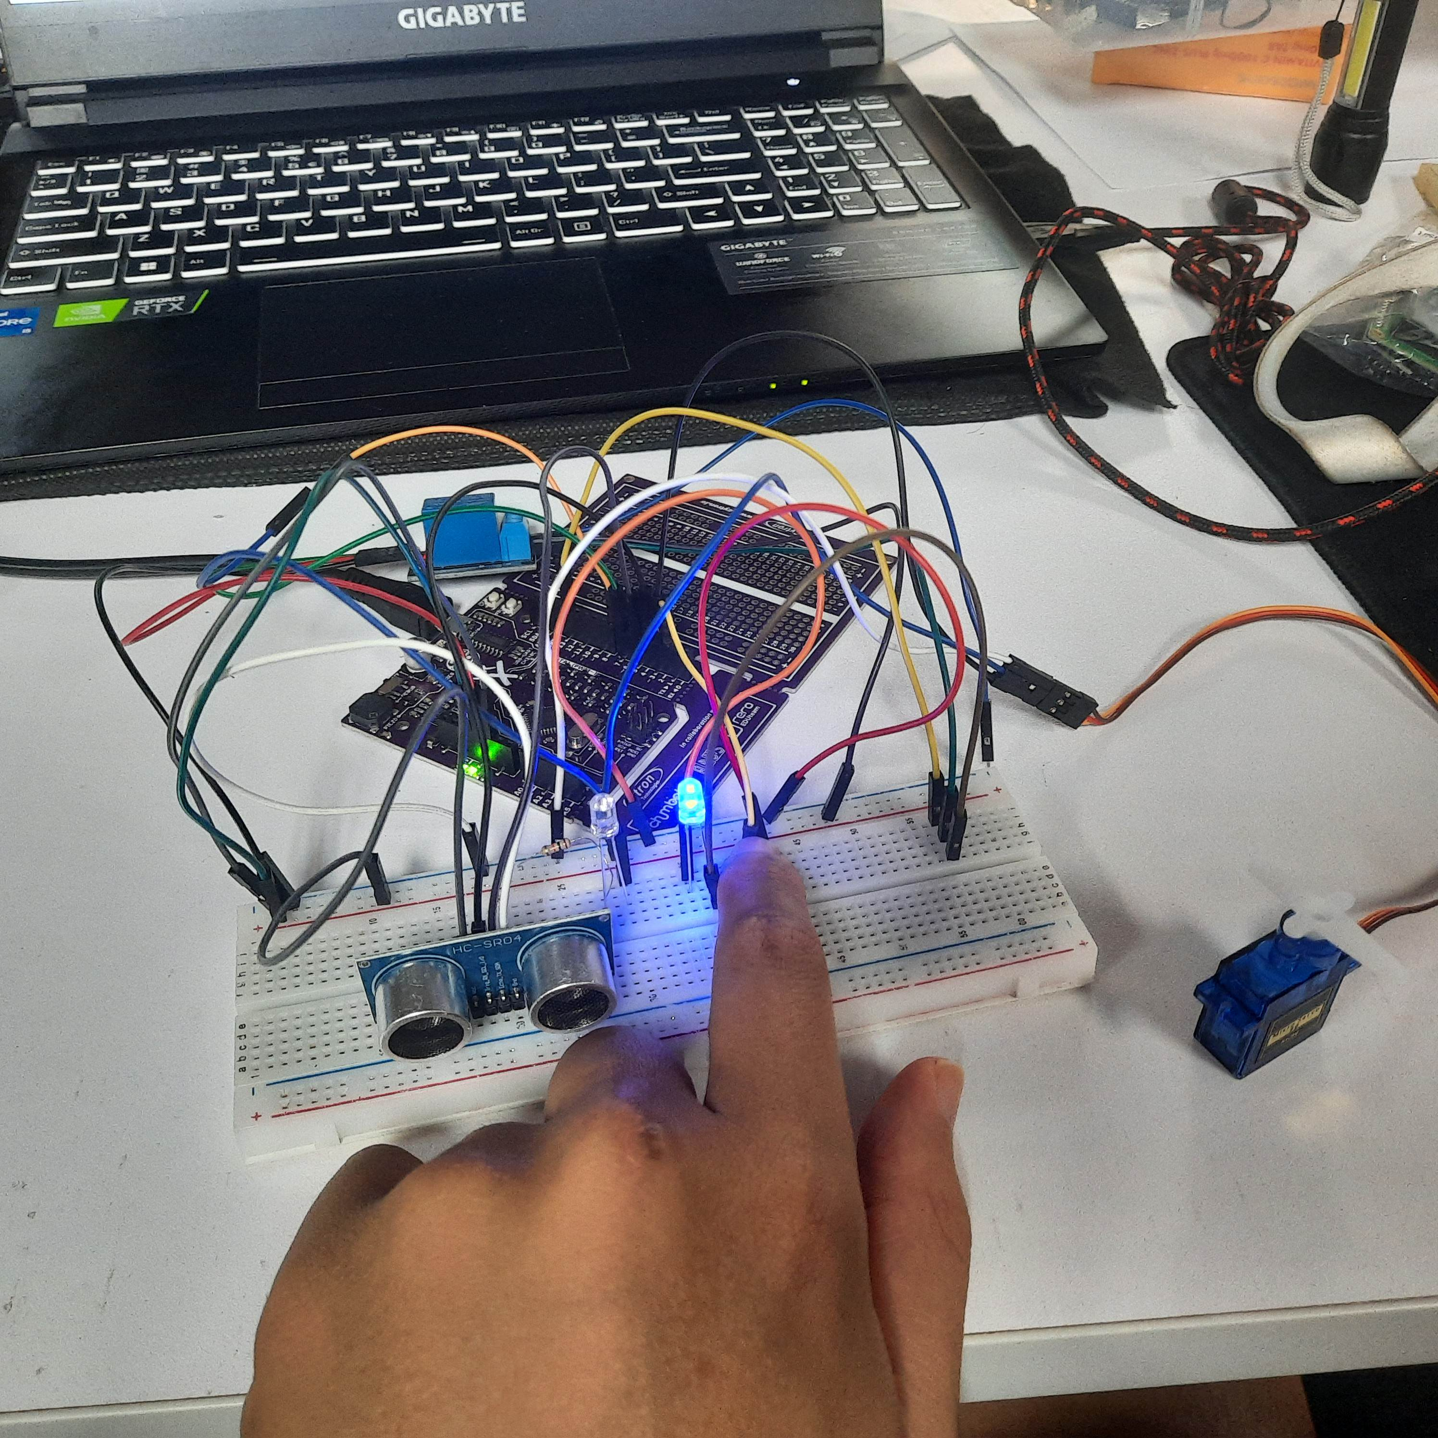
Automatic Gate Opener
BTE3262
ELECTRICAL AUTOMATION
project
Jehovah Yii Zui Hon
Wan Nor Samsiah Binti Wan Osman
Affrina Sahira binti Azham

Slide 2

Introduction
This project demonstrates how to control an automatic gate using a switch and a relay. The goal is to provide a secure and convenient way to access a property by using a simple switch that triggers the gate to open and close. The distance from the gate to an object is measured by an ultrasonic sensor and used to determine the state of the gate. When the distance is less than 5 cm, the gate is opened, and a green LED is turned on. When the switch is pressed, the relay is activated and the gate is opened, and a blue LED is turned on. The servo motor is used to provide visual feedback to the user, by swinging from 0 to 90 degrees when the switch is pressed and back to 0 degrees when the gate is closed.

Slide 3
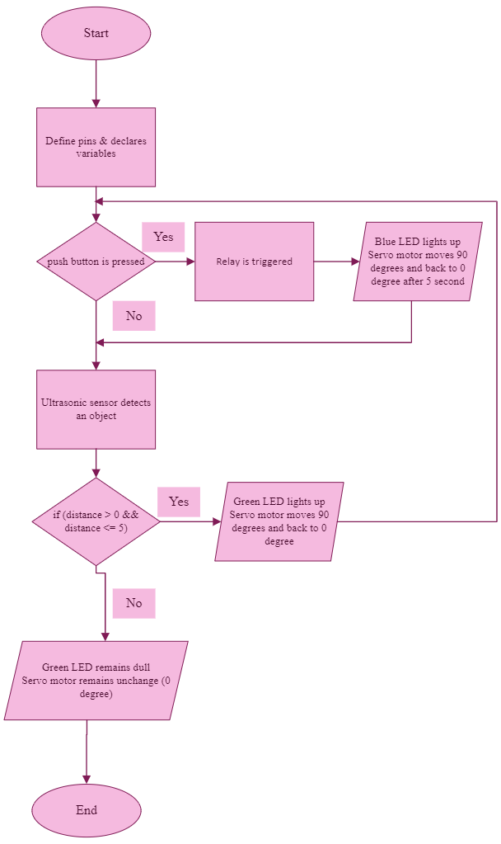

Flowchart
The purpose of the project is to measure the distance using an ultrasonic sensor,
Based on the distance, the system will perform different actions.
When the button is not pressed, the ultrasonic sensor continuously measures the distance,
If the distance is less than 5 cm, the green LED lights up.
When the button is pressed, the blue LED lights up, the relay is triggered, and
servo moves 180 degrees.

Slide 4
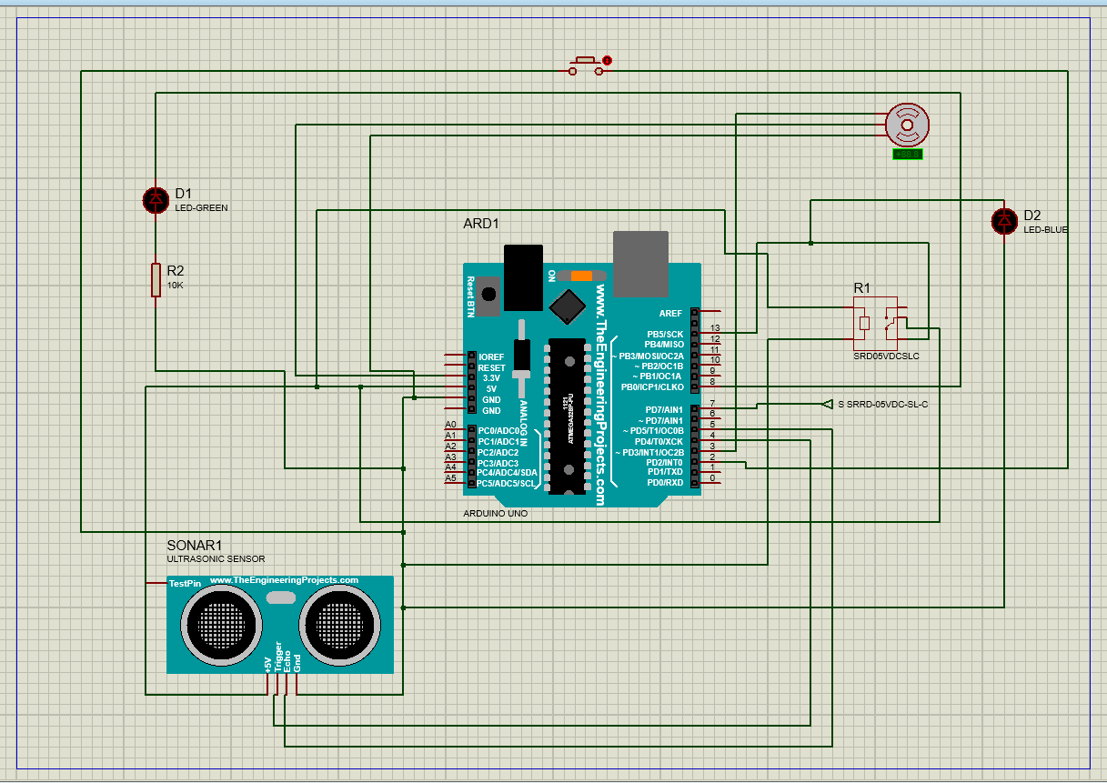
Circuit Diagram
Proteus Schematic diagram and connections
Ultrasonic Sensor
Vcc => 5V
Trig => D4
Echo => D5
Gnd => Gnd
Servo Motor
Yellow Wire => D3
Red Wire => 5V
Chocolate Wire => GND
Relay Switch
S => D7
+ => 5V
− −
=> GND
C => 3.3V
NO => D13
Green LED
+ => D8
− −
=> 10kΩ => GND
Blue LED
+ => D13
− −
=> GND
Push Button
Pin 1 => D2
Pin 2 Pin 2
=> GND

Slide 5
Advantages of the system
Benefits
Convenience: Automating the gate makes it easier for the user to enter and exit the property without having to get out of the car to manually open and close the gate.
Security: Automated gates provide added security as they can be designed to open only when an authorized person or vehicle is detected.
Time-saving: With an automated gate, there's no need to stop and manually open the gate, saving the user time and effort.
Increased property value: Automated gates can add value to a property as they are seen as a luxury feature.
Energy efficiency: Automated gates can reduce energy consumption as they don't require manual effort to open and close, reducing the need for electricity or other power sources.

Slide 6

Conclusion
In conclusion, this project of an automated gate system using an ultrasonic sensor, a relay, a servo motor and buttons, is a simple yet effective demonstration of how microcontrollers such as the Arduino can be used to control and automate physical systems. The code provided, which uses the Servo library and incorporates the control of a relay, blue LED and green LED, effectively implements the desired functionality of the gate opening when the car comes near it and also allowing manual opening with the button press. The code can be further optimized and improved upon with the implementation of more advanced features such as safety measures and smoother servo movement. The wiring of the relay with the Arduino must be done correctly to avoid any errors or malfunctions in the system. Overall, this project provides a foundation for future development and implementation of automated gate systems in real-world applications.

Slide 7
Gantt Chart
Forecasting for success
Task | W11 | W12 | W13 | W14 | W15
Lecturer give the project task
Searching for Project automation
Implementation of hardware
Hardware testing
Create report and slide
Presentation

Slide 8


Thank You
Jehovah Yii Zui Hon
Wan Nor Samsiah Binti Wan Osman
Affrina Sahira binti Azham
Faculty of Electrical and Electronic Engineering Technology
UNIVERSITI MALAYSIA PAHANG

